Slide 1

Kubernetes Networking – A deep dive

Slide 2
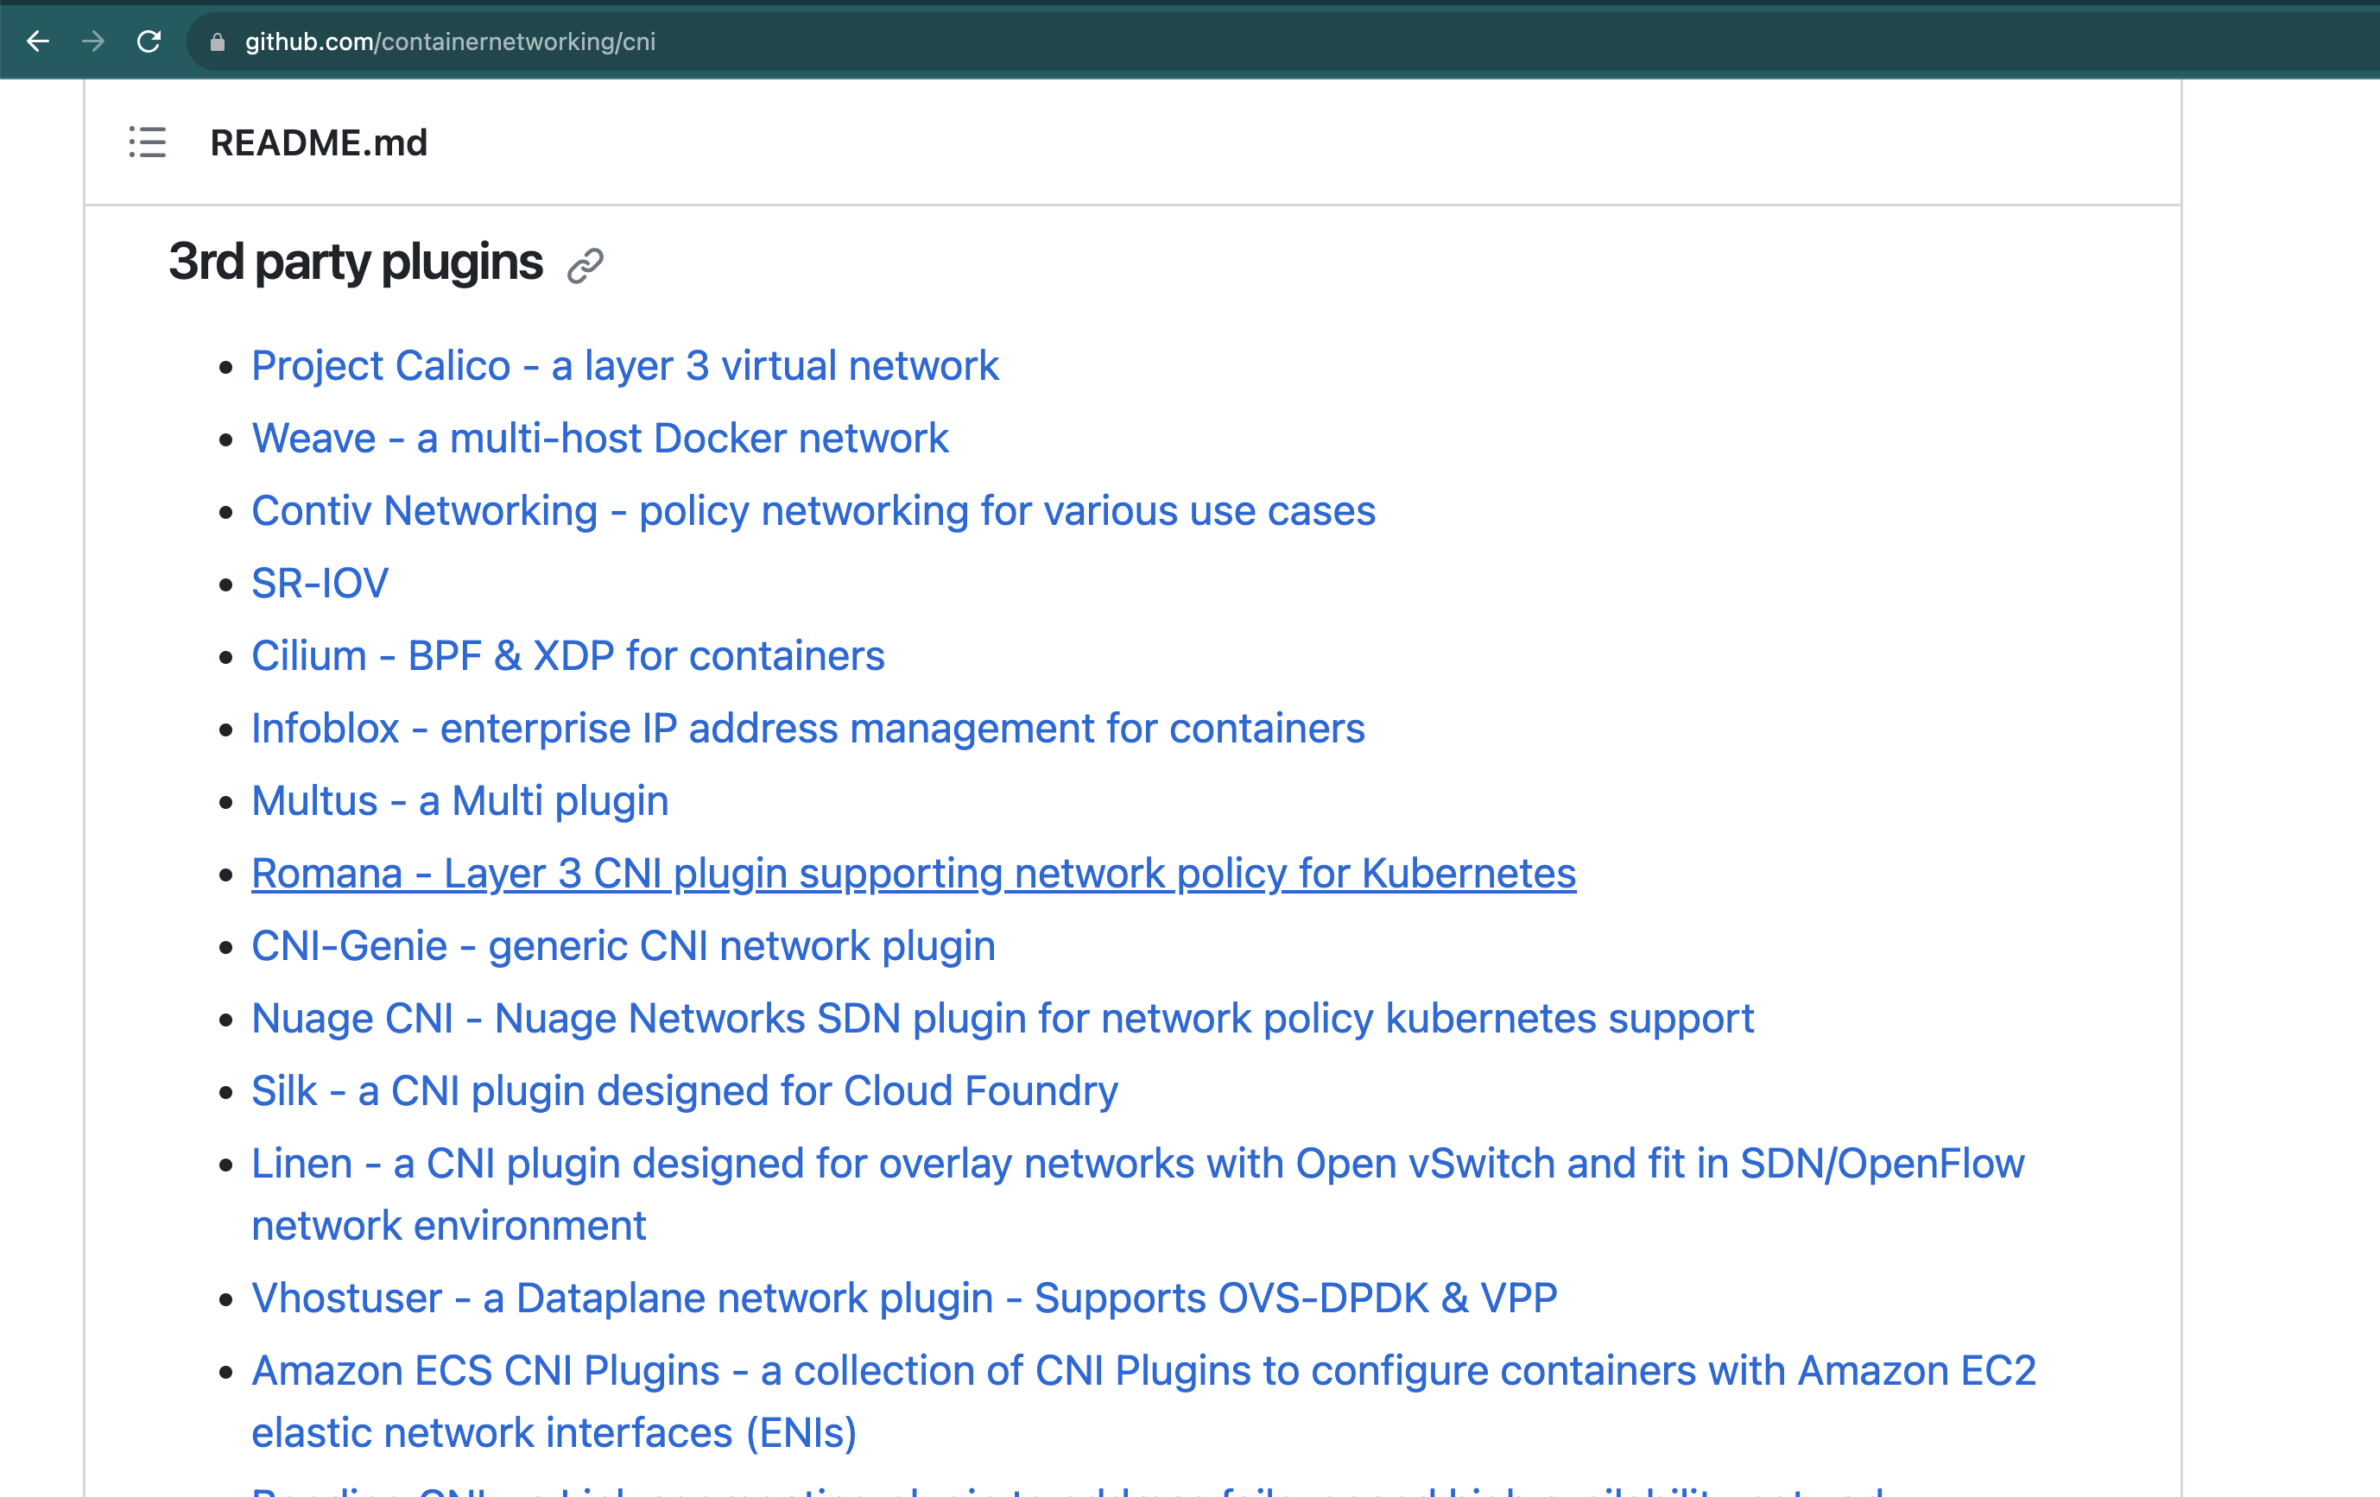
Third Party Plugins

Slide 3

Networking is YOUR choice

Slide 4
Layers in K8s network.
Pod to Pod
Service to Pod
Policy Layer

Slide 5
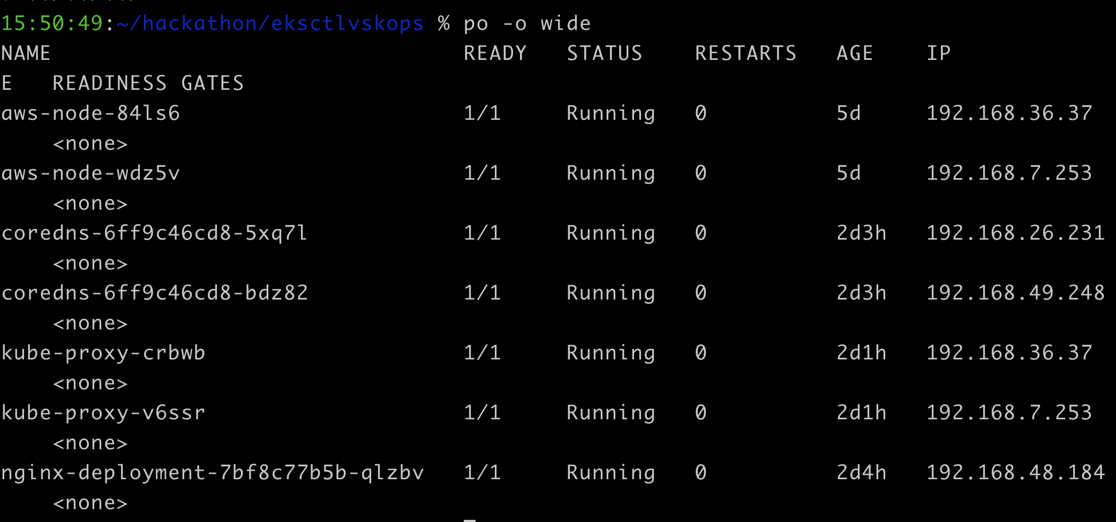
Kube-system

Slide 6
Combinations – A perspective
S.No | POD networking | Service Networking | Network Policy
1 | Cilium | Kube-proxy | Gatekeeper

Slide 7
Do you want pod networking change?
What can you change it with in cloud?
Overlays – A tunnel with UDP encapsulation
Native Routing – Cloud provider's router/ Linux Routing Daemon
Use cases:
Multi tenancy
Defined Performance metrics
Pod to pod encryption

Slide 8
Do you want Service Networking change
Kube-proxy slow
Service – 5 iptables rules
Iptables vs IPVs vs anyother technology eg: eBPF

Slide 9
Network Policies
Default N/W policy
Cloud provider’s default N/W policy
Multi cloud support
Network Security for Micro services
Layer3 Layer 4,Layer 7 Policy ( HTTP, grpc, kafka )

Slide 10
Combinations - Experimented
S.No | POD networking | Service Networking | Network Policy
1 | AWS VPC | cilium | NA
2 | AWS VPC | Kube-router | NA
3 | Cilium | Kube-proxy | NA

Slide 11
Recommendations
Default kube-proxy with any CNI plugin
Service layer change with pod layer change – same plugin
Service translations alone – tread with caution after testing it extensively
Network policies – Check for compatibilities, usually on the same plugin.

Slide 12

Thank You
Gayathri Natarajan
Associate Architect, Presidio
gnatarajan@presidio.com

Slide 13

Your feedback is important !

